Slide 1
Mobile Heartbeat Advanced Education
Broadcasts
IT Education Analyst

Slide 2
Session Objectives
At the end of the Mobile Heartbeat session, you will understand:
What Broadcasts are
How to send a Broadcast
Choosing an intended audience
Quick Broadcasts
Dual Process for emergencies

Slide 3
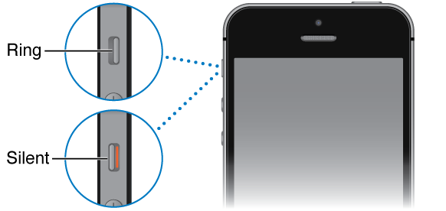
Important at Time of Log In
Check your Sound Settings
Be sure the device was not switched to silent.
Check the volume of the device to ensure you will be able to hear it.
NOTE: Turning the device to silent increases the risk of alerts and alarms to be missed. This becomes a patient safety issue.

Slide 4
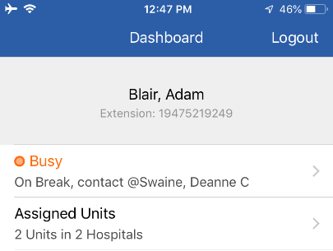
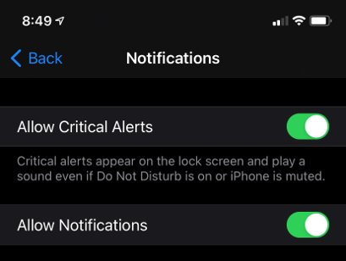
Important Settings
Shared Device Users
BHVoice
Airplane Mode
Properly connect to the network
Prevents battery drain
When devices complete an update, Airplane Mode must be reenabled
Personal Device Users
BHGuest
Be sure to Allow Critical Alerts within the app
If you own an Apple Watch, disable notifications for MH-Cure
Notes:
Discuss how to reenable Airplane mode from settings.

Slide 5
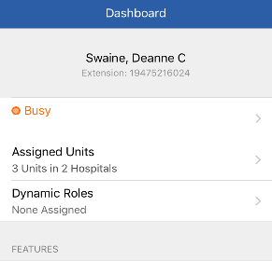
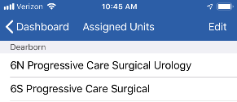
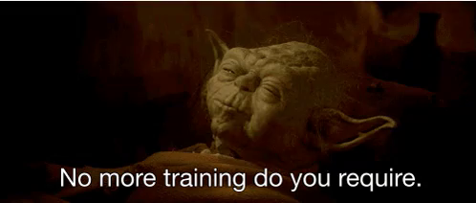
Remove Yourself from Training Unit
Navigate to the Dashboard.
Select Assigned Units.
Tap Edit
Remove yourself from *zTraining/*New User (Dearborn) and/or Go Live
Notes:
Nurse Call will NOT work if they don’t remove zTraining!
And they will see the training “Hiccup” patients!

Slide 6
Broadcasts

Slide 7
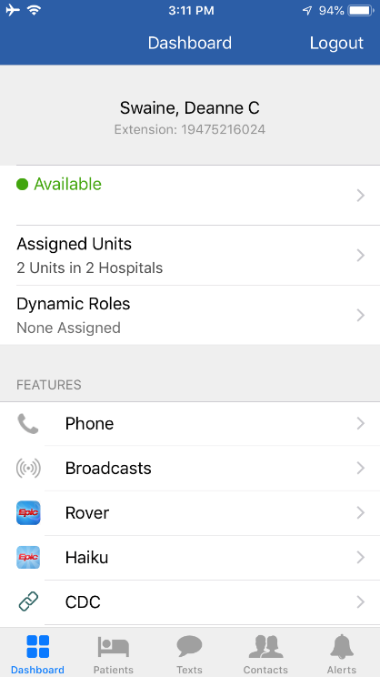
Broadcasts
Send critical information to a group of people quickly.
Ensure the right message gets to the right people.
Commonly used for:
Medical Alerts
Security Alerts
Facility-wide messages

Slide 8
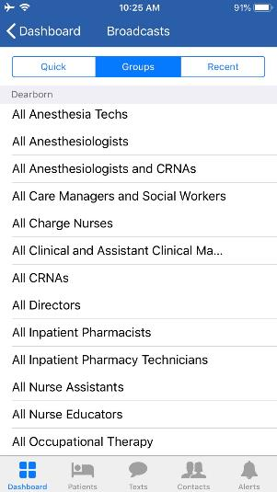
Broadcasts
Predefined group of people (this can include people signed into a dynamic role)
Quick: All standardized broadcast groups (Medical alerts are not active for all sites)
Behavioral Response Team (BRT)
Adult CPR
RRT
Groups: All groups you can send a broadcast to (be sure you are sending to the correct audience (i.e. your unit or hospital)
All RNs
All CRNAs
All Unit Staff
Recent: All broadcasts you have sent and received (up to three days)
Notes:
Broadcast vs Group text
Broadcasting is similar to group texting, however, the people/roles included in the group are predetermined and cannot be adjusted.
Group texting allows for the sender to pick and choose who will receive the message.
Select Quick, Groups, or Recent
Select Location
Choose the Unit
Example: If I am the Nurse Manager and I know I am going to be short next week, I can send a broadcast to all of my floor nurses, “What is your availability next week, we are going to be short?” When people
Text Blasting “ Simple, one-way text messages are sent to a list of recipients. This feature is useful for public, health alerts or health education campaigns.
respond, I am the only one who will receive that message.
CAUTION: Broadcasts are now open to all 5 hospitals that are up on MHB so careful to not pick a group e.g. All CRNAs as will broadcast to all hospitals. Check on this statement as mentioned by Sherrie Krohta.

Slide 9
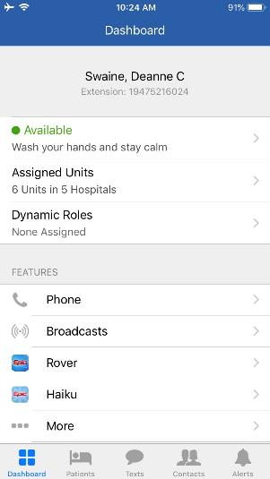
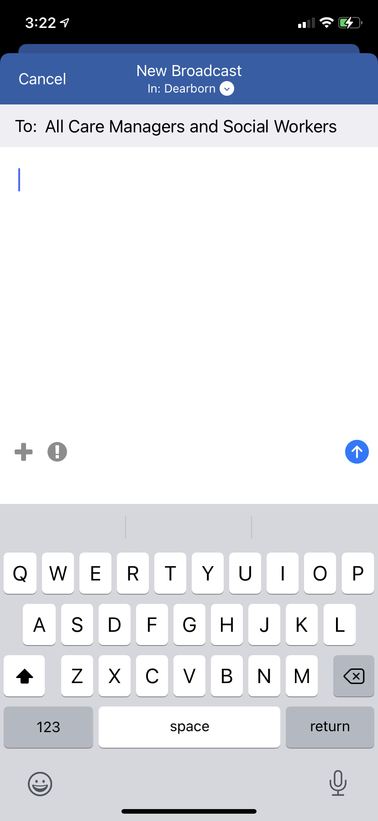
Sending a Broadcast
A message from an individual to a Broadcast group.
You cannot create your own broadcast group, use group texting instead.
Notes:
More to come next month. Sending Messages.

Slide 10
Intended Audience
Ensure you are sending the message to the intended audience.
Check the top and confirm the audience is correct.
Tap the white downward facing arrow to change audience.
Unit Only – sent to the specified group in the unit selected
Hospital Only – sent to the specified group in the entire hospital
Anywhere – sent to the specified group at every site (yes, ALL sites!)
Notes:
Do not select Anywhere, this should be used by leadership and in disaster situations.

Slide 11
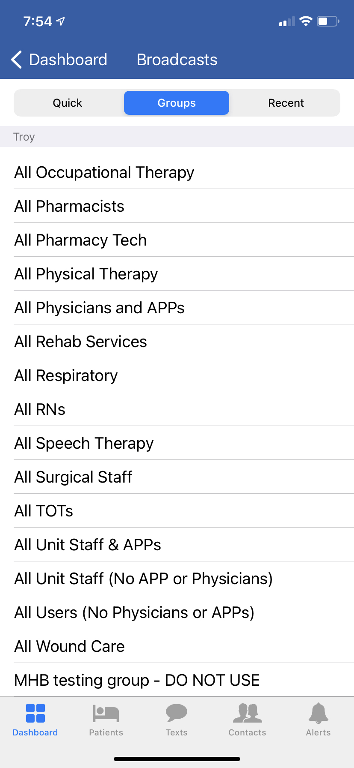
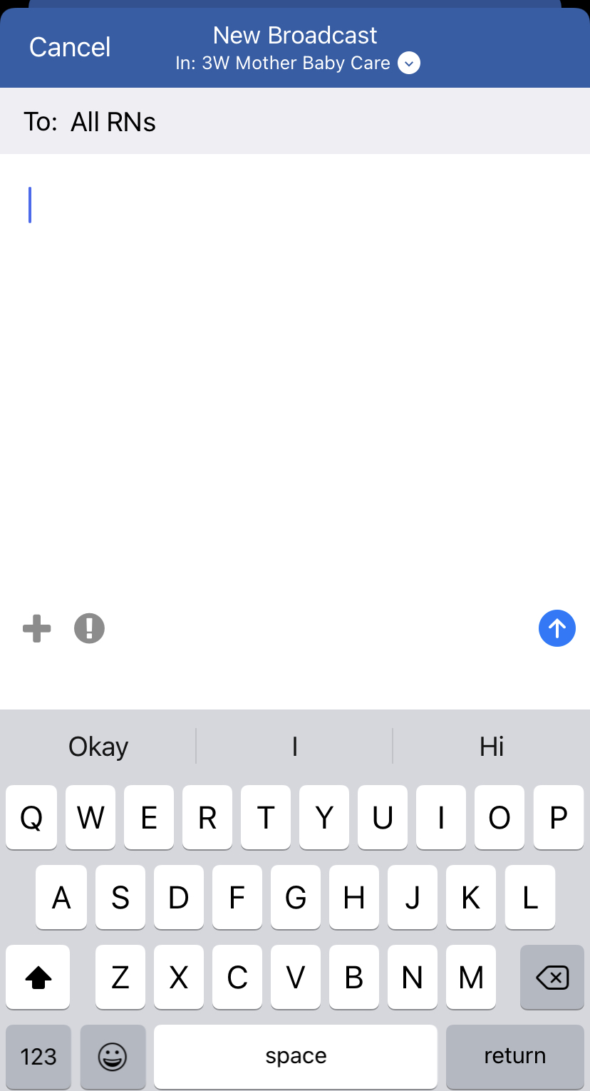
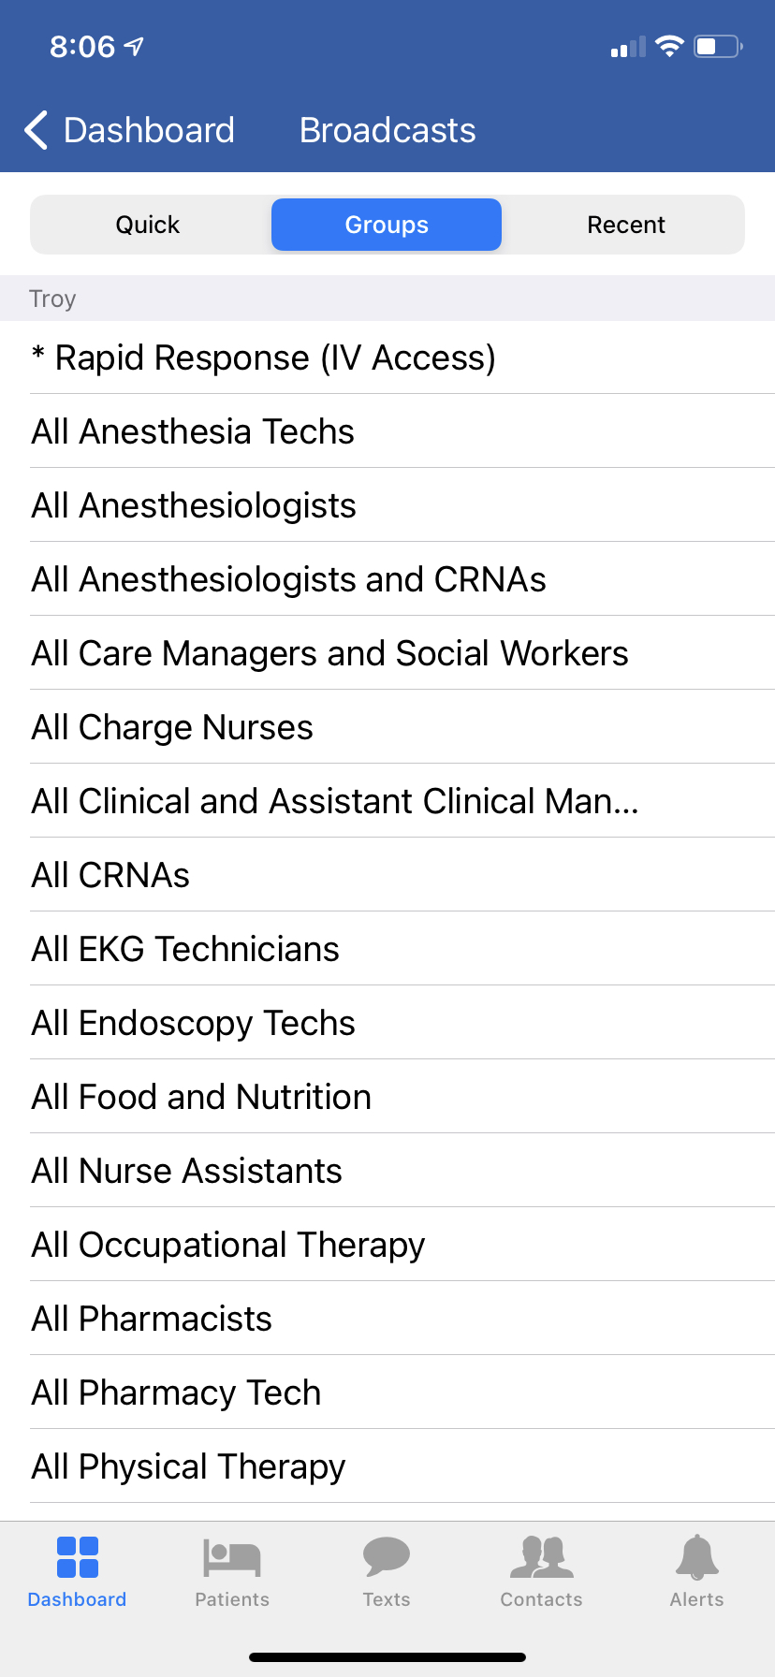
Send a Broadcast

Slide 12
Broadcast Message to a Specific Group
When a person sends a message to a group, all members receive message. If someone in the group responds, only the sender will receive the message.
Thank you!
The surveyor is beginning a building tour with Jeremy. Please be prepared.
Notes:
You can only respond to the person who sent a broadcast, not to the whole group.

Slide 13
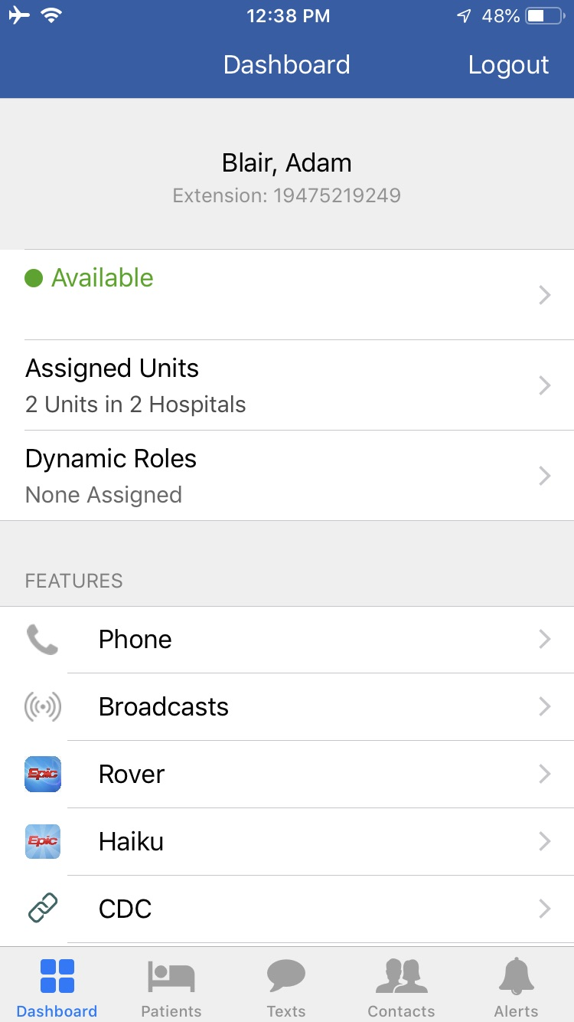
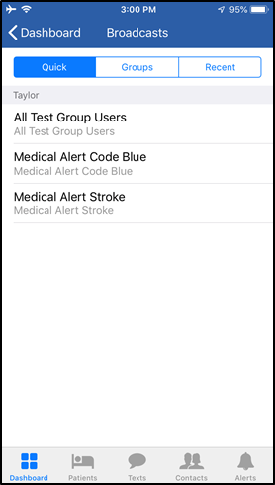
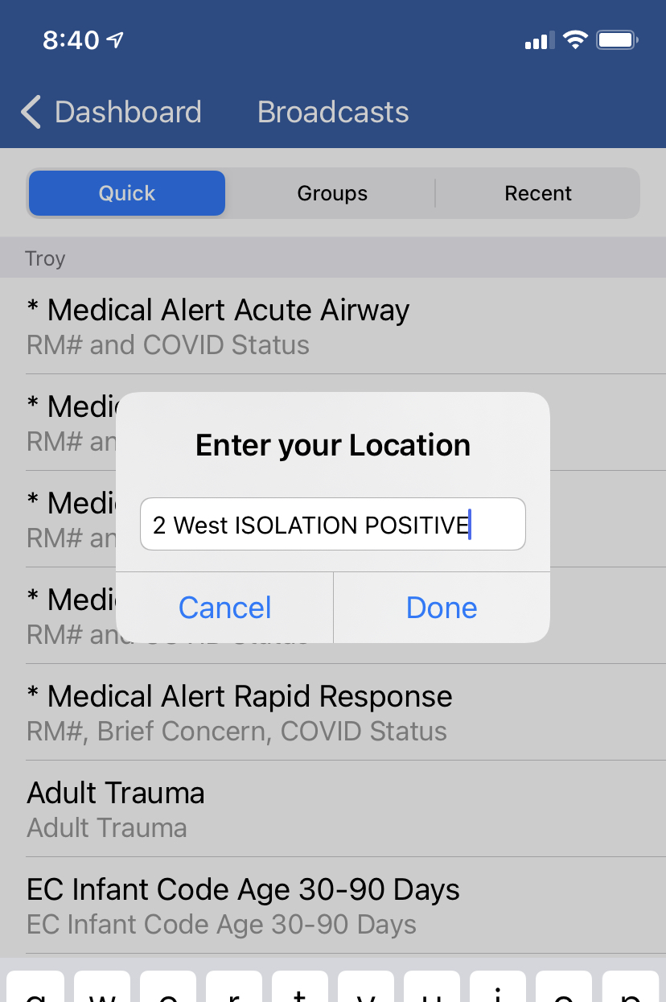
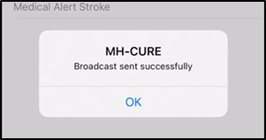
Quick Broadcast
This is a dual process
Add COVID/Isolation Status
Notes:
Quick Broadcast vary between sites so there may be some slight differences if you work at more than one location.

Slide 14
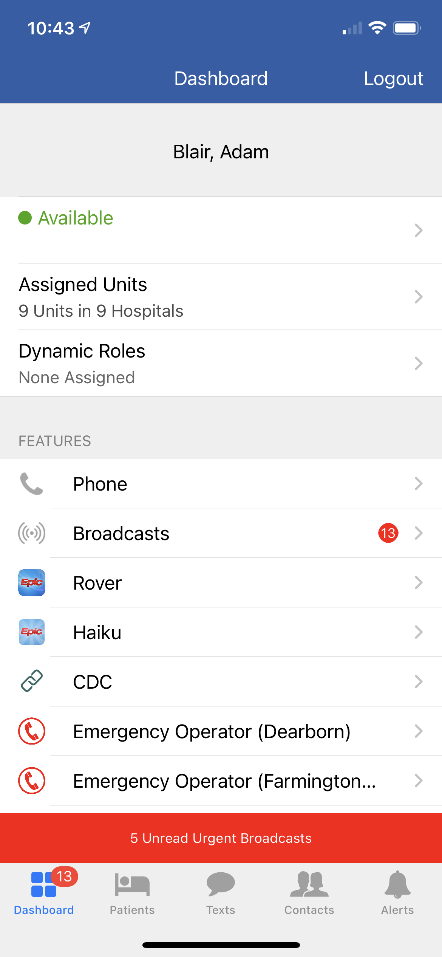
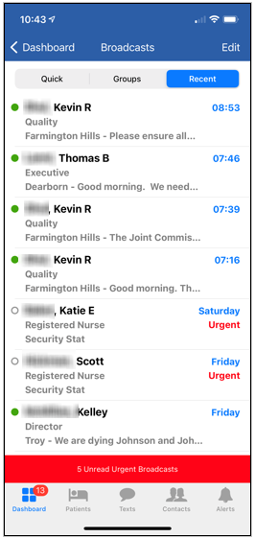
Recent Tab

Slide 15
Quick Broadcasts
Dual process
Dial the operator
Use the Dashboard screen to access the Emergency Operator for your site.
Send a Quick Broadcast to the appropriate audience
Ensure correct group has been selected (area and hospital)
Include specific location
Include isolation status of patient
Confirm everything is correct prior to sending

Slide 16
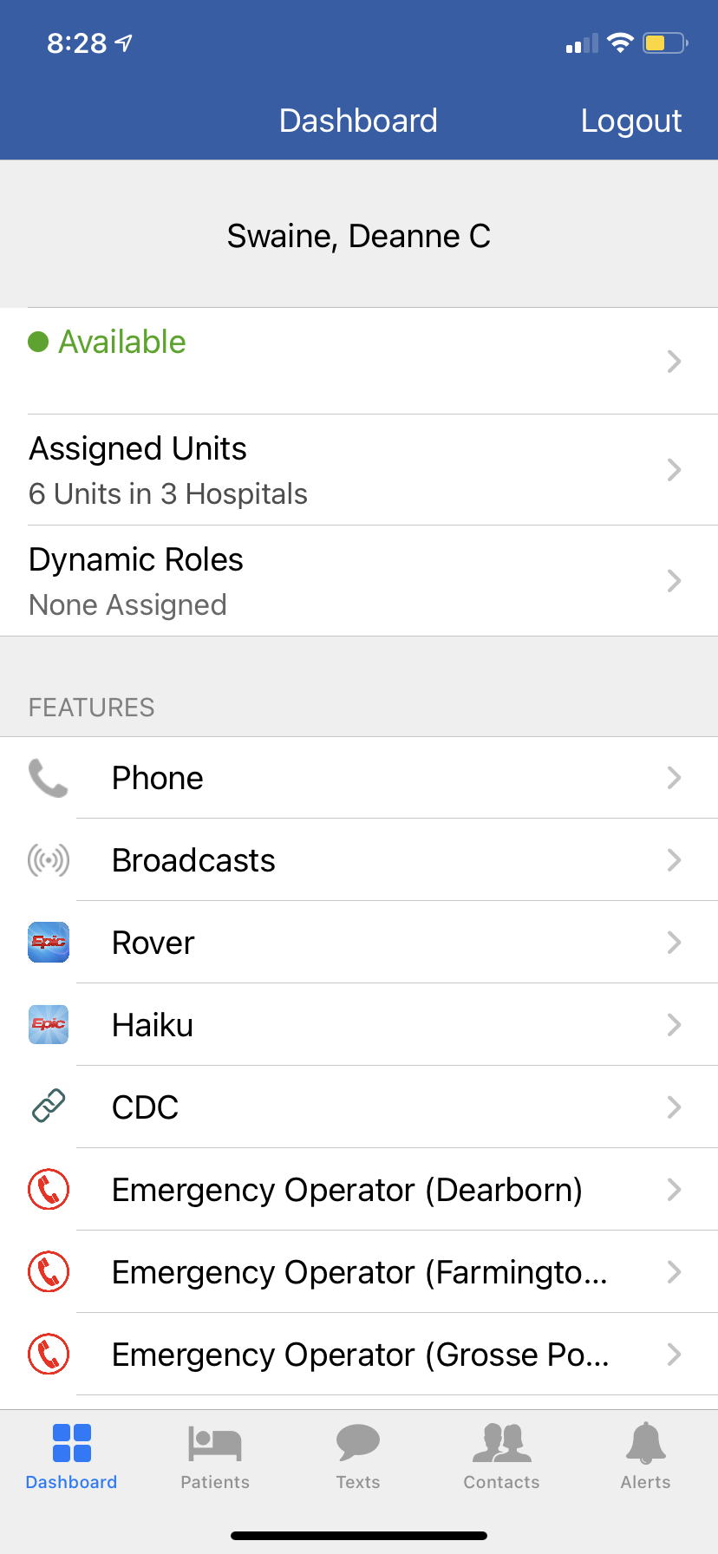
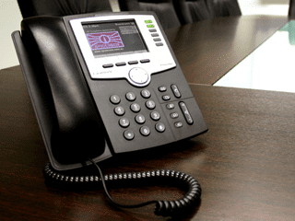
Medical Alert Response
Primary Response
Dial the operator using your quick dial number from a desk phone.
555
888
Use the Emergency Operator number from the Dashboard
Secondary Response
Use the appropriate Quick Broadcast
Notes:
Not available for Android users

Slide 17
Logout
Manually log out of application
The docking station should log you out.
When the phone is docked properly, a red light displays on the docking station indicating that it is charging.
Green light means device is fully charged.
Manually logging out ensures that you no longer appear available to hospital staff.
If a device is plugged into a charging cord, Mobile Heartbeat will log out.

Slide 18
Additional Information

Slide 19
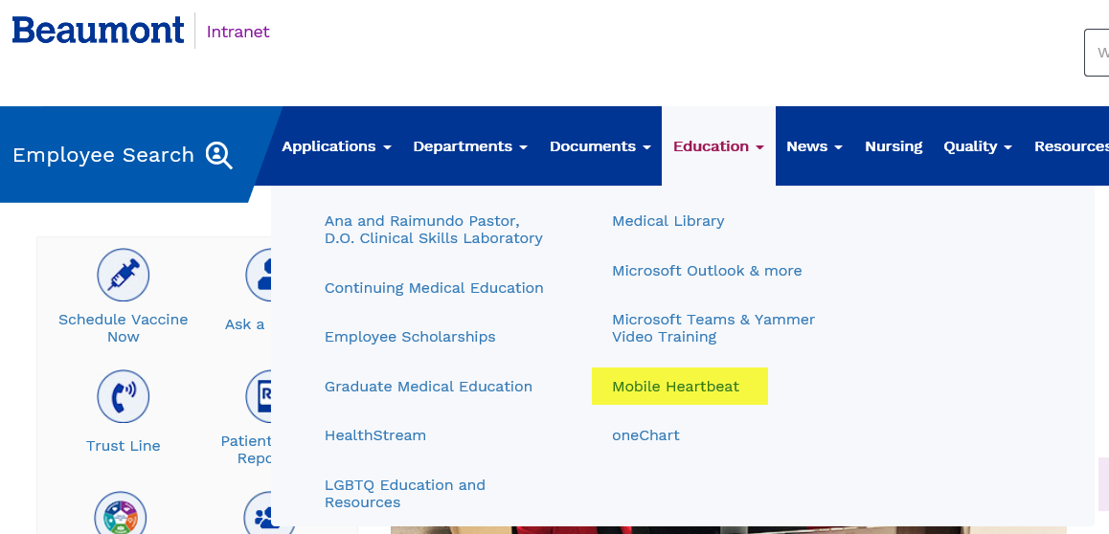
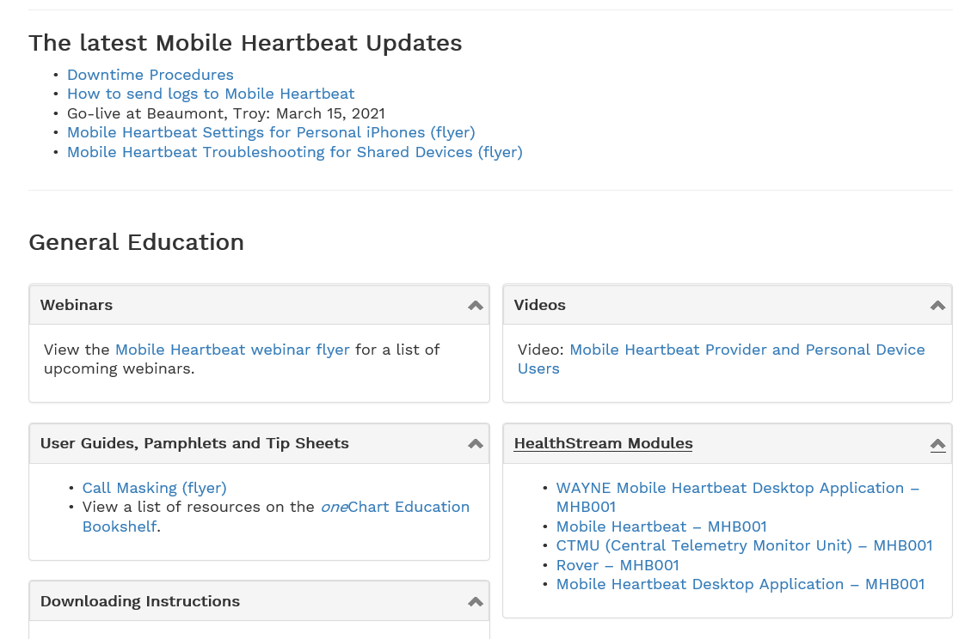
Beaumont Intranet > Education > Mobile Heartbeat
Dates and times for Advanced Webinars
The website is constantly changing
Mobile Heartbeat has regular updates
Reminder when a shared device has an update, airplane mode must be enabled again

Slide 20
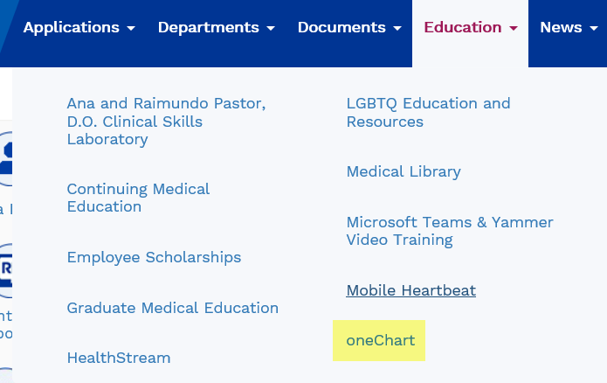
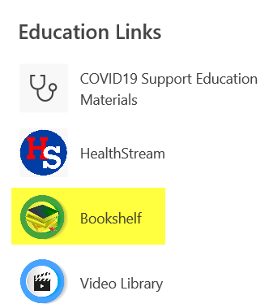
Beaumont Intranet > Education > oneChart > Bookshelf > Mobile Apps

Slide 21
Upcoming Sessions
Sending Messages
Dynamic Roles
Provider Education
Resources
Upgrades

