Slide 1
Beaumont Physician Leadership Academy Mentoring Guide Meeting Our Vision through Exceptional Administrative-Medical Staff Collaboration
Learn more at: https://providers.beaumont.org/bpla Sept 2019

Slide 2
Beaumont Physician Leadership Academy Better Care. Improved Partnerships. Enhanced Organizational and Individual Vitality.
BPLA is designed to develop physicians who will provide leadership for enhanced clinical outcomes, process/program design, and cost-effective service delivery innovations needed to better serve our patients, our communities and our physicians.
The Academy consists of a nine-month curriculum of monthly educational sessions. Group project work and executive mentoring are also part of the BPLA experience. Classes are held in a centralized location.
The involvement of senior leadership in the BPLA, particularly as mentors, affords opportunities for strengthened administrative-medical staff partnerships, ultimately benefiting patients, Beaumont Health, and the communities we serve.

Slide 3
A bit about BPLA:
Academy Highlights from 2011 – 2019
Over 225 Beaumont physicians are now BPLA alumni.
Over 160 provide leadership to the System including five chief medical officers, four elected chiefs/presidents of staff, 29 vice chiefs and 14 chairs.
Completion of BPLA now considered when the organization seeks physician input and identifies potential leaders
Representation from all eight hospitals is the norm.
“BPLA provides a valuable opportunity for internal and personal growth. It is a valuable introduction to the corporate world of medicine which physicians generally have little experience with during training or practice. The relationships with other physicians going through the process I found to be liberating. We tend to spend our work lives in 10x10 rooms, isolated from other physicians. In that setting it is easy to envision we are along in our struggles and it is hard to see the bigger machine in which we serve as a small part. The BPLA is an eye opening experience which challenges your assumptions about yourself. The commitment of BH to its stated goals and ideals is palpable. The focus on diversity and inclusiveness was clearly evident.” 2017 Fellow

Slide 4
An Additional, Essential Element to BPLA are Beaumont Leaders willing and ready to serve as mentors:
What is the role of a mentor to the BPLA participant(s)?
What is the expected time investment?
What is the competency framework for the physician leaders?
What are some specific suggestions regarding how to spend our time most productively during our mentoring sessions? How do we assure the most developmental value?
What are the short and longer-term benefits to the physician(s), to Beaumont, and to me?
“Mentoring was the most useful part of the program for me. My mentor gave me tips I could put to use right away with great results. Everyone should make an effort to spend time with a mentor and gain from their life and professional experience.” 2016 Fellow

Slide 5
Your Role as a BPLA Mentor
Many Potential Hats:
Teacher: filling in gaps between classroom learning and the day-to-day practical know-how of running a complex healthcare operation. Providing a ‘day in the life’ experience of joining the mentor in meetings and programs can be enlightening.
Developer: assisting fellows in understanding interpersonal leadership strengths and weaknesses based on guided self-reflection and behavioral feedback—learning to understand non-verbal behavior of others in order to increase emotional intelligence.
Networker: Helping fellows understand the functional layout of the organization, job titles and structures, and rationale for how the many moving parts connect.
Navigator: Helping fellows navigate politics and bureaucracy—not only informing as to who has authority, but who has influence. Learning to understand and manage political sensitivities is a part of effective leader development.
Promoter: An accomplished mentor can also help promote the participation of physicians on multidisciplinary teams or stretch work experiences within the organization to assure that work experiences shore up classroom learning.
Career Coach: For those physicians seeking to move into successively responsible leadership roles, the mentor supports the fellow in crafting a career road map to achieve his or her longer-term career goals.

Slide 6
What is the Expected Time Investment for a Mentor?
What yield do you desire for the organization? The physician fellows? For your own leadership investment? Our suggested baseline time investment is:
1X/month to meet and debrief the learning sessions with your mentee(s) during the fellowship trajectory is ideal however it is asked that you will meet or talk with your mentee/mentor no less than THREE times and have at least one meeting by the end of April.
There may be significant benefit to varying time spent between one-on-one sessions AND a small group convening with multiple mentees. Small group meetings are an effective and efficient way to learn with and among each other
At some point in the first 60-90 days, we suggest you establish a day of shadowing—part of the day in the executive’s world, part of the day in the physician’s world.
There may be specific meetings of interest to both the mentor and fellow that you may invite each other to attend—learning more about the organization and issues facing Beaumont Health.

Slide 7
Suggestions to Best Leverage Your Time Together:
As you establish your mentoring relationship, early stage discussions should focus on developmental planning:
In your first meeting we suggest you meet for breakfast, lunch or dinner—get to know each other’s backgrounds, future plans, specific goals for learning, potential career ambitions, strengths and weaknesses, an other professional discussion. Use the “Getting to Know You” questions as your starter (slide 9).
What are the strengths and development opportunities vis-à-vis the Beaumont Physician Leadership Academy Competency Framework (slide 10)?
Each of the fellows has completed an assessment of their leadership style by TRACOM and provided written and oral feedback. Based on the Social Styles and Versatility Concepts report from Tracom: In the context of the competency framework, what are the mentee’s relationship and leadership strengths? What are some possible blind spots relative to interpersonal effectiveness? How can these be further developed? Are the strengths well-leveraged in the fellow’s current role? How might the fellow gather additional data to assess his or her effectiveness with others—whether with other medical staff, nursing, administrators, front-line staff or patients?
What reading do you suggest for your fellows? What are articles or other key sources of information that you feel the fellow will benefit from, while not inordinately impacting his or her time?

Slide 8
Leveraging Your Time Together (continued):
Additional Suggestions:
In considering the strategic direction of Beaumont, what does the fellow need to know about the overall plan of our organization?
What is the process for strategic planning? Who are the key drivers of the plan? How are results measured?
What is Beaumont’s competitive advantage? What are it’s biggest threats?
What are the major challenges and change initiatives are underway in your ‘world’ at Beaumont?
How can the fellow incorporate this new knowledge in order to improve his or her contribution to Beaumont?
What specific business and financial skills does the fellow want and need to learn? Who provide the best resources internally to bridge these learning gaps?
How can the fellow learn to balance commitments to work, profession, organization, family and community?
Finally, what are some pending projects or initiatives that the fellow could become involved in so as to fully leverage the fellowship learning and development discussions?
What is your role in supporting our PFCC Moonshot?

Slide 9
That First Meeting – Getting to Know You
What “have you done/what do you do” to prepare yourself to grow in your career?
How do you "manage up"?
How do you deal with "burnout"?
How do you effectively partner with other members of your teams?
How do you balance the expectations and pressures of work and family?
How do I find time for me?
What are the accomplishments that you are most proud of, and how did you achieve them?
What are the hard lessons you learned in your last ten years and how are you different/wiser today?
What are the essential elements of business that I should equip myself with to continue to grow in management and leadership?
How do you get feedback? How do you give feedback?
What are your strategic imperatives? How do you measure your efforts?
Let’s talk about the group project – what I’m doing, where the group is at, next steps and anyway you might be helpful.

Slide 10
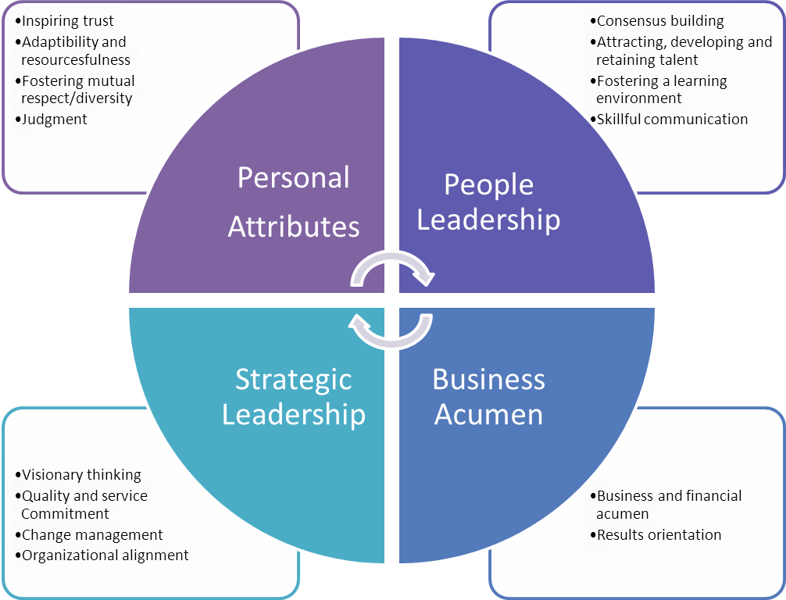
BPLA Leadership Competency Framework

Slide 11
Some Past Mentor Observations & Practices:
Most mentors and fellows met at least 3-4 times; however, a few mentors met less. Several reported meeting 6 or more times. Types of meetings including formal sessions, lunch or coffee, impromptu hall or ‘open door’ sessions.
Some mentors extended invitations to shadow or attend administrative meetings.
Some made a point of making or providing introductions of their fellows to others that might be helpful to the fellow’s personal /professional growth or BPLA project work.
A majority of mentors as well as additional Beaumont leadership attended the September BPLA small group project presentations.
“This was my first experience with the BPLA. I was very impressed with the leadership and organization of the course.” Past Mentor

Slide 12
Final Thoughts:
As a result of this experience, the vast majority of mentors overwhelming agreed that:
My mentee is better equipped to be a physician leader
I would recommend my mentee for an Beaumont committee, taskforce, etc.
This program added to my personal career satisfaction
This program should be included again in BPLA
Learn more about BPLA at: https://providers.beaumont.org/bpla
Questions? jeanne.sarnacki@beaumont.org or 947-522-1838
Thank You!

